Slide 1
UNIT 5
RISK AND CONFIGRUATION MANAGEMENT

Slide 2
What Is Software Risk?
Risk is an expectation of loss, a potential problem that may or may not occur in the future.
It is generally caused due to lack of information, control or time.
A possibility of suffering from loss in software development process is called a software risk.
Loss can be anything, increase in production cost, development of poor quality software, not being able to complete the project on time.

Slide 3
Types of software risks
Software risk exists because the future is uncertain and there are many known and unknown things that cannot be incorporated in the project plan.
A software risk can be of two types
  (1) internal risks that are within the control of the project manager and
  (2) external risks that are beyond the control of project manager.

Slide 4
Definition of Risk
A risk is a potential problem – it might happen and it might not
Conceptual definition of risk
  Risk concerns future happenings
  Risk involves change in mind, opinion, actions, places, etc.
  Risk involves choice and the uncertainty that choice entails
Two characteristics of risk
  Uncertainty – the risk may or may not happen, that is, there are no 100% risks (those, instead, are called constraints)
  Loss – the risk becomes a reality and unwanted consequences or losses occur

Slide 5
Risk Categorization – Approach #1
Project risks
  They threaten the project plan
  If they become real, it is likely that the project schedule will slip and that costs will increase
Technical risks
  They threaten the quality and timeliness of the software to be produced
  If they become real, implementation may become difficult or impossible
Business risks
  They threaten the viability of the software to be built
  If they become real, they jeopardize the project or the product
(More on next slide)

Slide 6
Risk Categorization – Approach #1 (continued)
Sub-categories of Business risks
  Market risk – building an excellent product or system that no one really wants
  Strategic risk – building a product that no longer fits into the overall business strategy for the company
  Sales risk – building a product that the sales force doesn't understand how to sell
  Management risk – losing the support of senior management due to a change in focus or a change in people
  Budget risk – losing budgetary or personnel commitment

Slide 7
Risk Categorization – Approach #2
Known risks
  Those risks that can be uncovered after careful evaluation of the project plan, the business and technical environment in which the project is being developed, and other reliable information sources (e.g., unrealistic delivery date)
Predictable risks
  Those risks that are extrapolated from past project experience (e.g., past turnover)
Unpredictable risks
  Those risks that can and do occur, but are extremely difficult to identify in advance

Slide 8
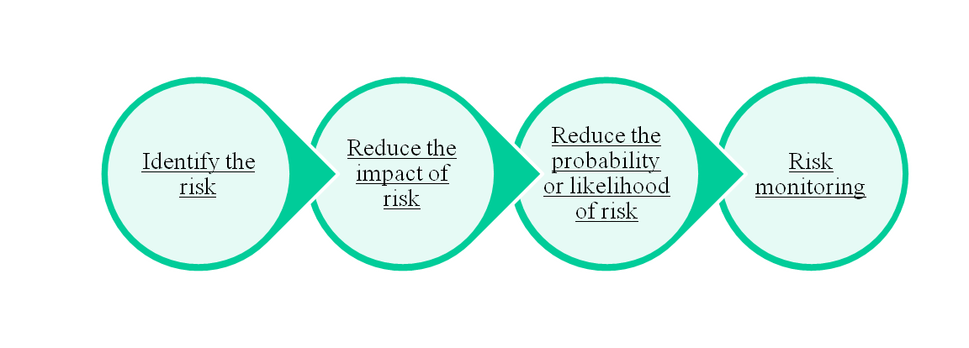
Risk Management
Risk management is carried out to:
  Identify the risk
  Reduce the impact of risk
  Reduce the probability or likelihood of risk
  Risk monitoring

Slide 9
Reactive vs. Proactive Risk Strategies
Reactive risk strategies
  The majority of software teams and managers rely on this approach
  Nothing is done about risks until something goes wrong
Proactive risk strategies
  Primary objective is to avoid risk and to have a contingency plan in place to handle unavoidable risks in a controlled and effective manner

Slide 10
Steps for Risk Management
Identify possible risks; recognize what can go wrong
Analyze each risk to estimate the probability that it will occur and the impact (i.e., damage) that it will do if it does occur
Rank the risks by probability and impact
- Impact may be negligible, marginal, critical, and catastrophic
Develop a contingency plan to manage those risks having high probability and high impact

Slide 11
Risk Identification
Risk identification is a systematic attempt to specify threats to the project plan
By identifying known and predictable risks, the project manager takes a first step toward avoiding them when possible and controlling them when necessary
Generic risks
  Risks that are a potential threat to every software project
Product-specific risks
  Risks that can be identified only by those a with a clear understanding of the technology, the people, and the environment that is specific to the software that is to be built
  This requires examination of the project plan and the statement of scope
  "What special characteristics of this product may threaten our project plan?"

Slide 12
Risk Item Checklist
Used as one way to identify risks
Focuses on known and predictable risks in specific subcategories (see next slide)
Can be organized in several ways
  A list of characteristics relevant to each risk subcategory
  Questionnaire that leads to an estimate on the impact of each risk
  A list containing a set of risk component and drivers and their probability of occurrence

Slide 13
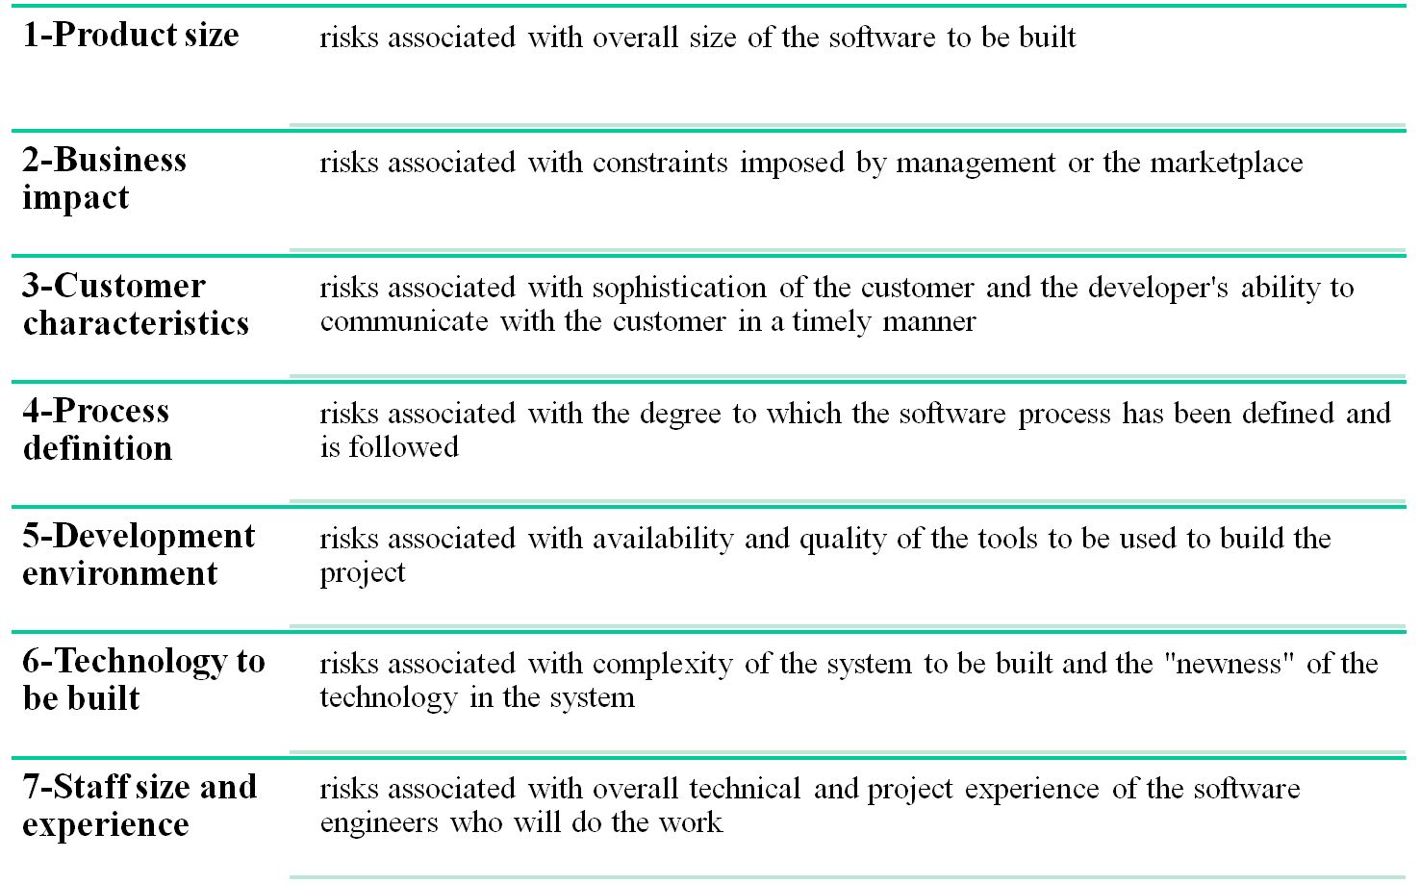
Known and Predictable Risk Categories

Slide 14
Recording Risk Information
Project: Embedded software for XYZ system
Risk type: schedule risk
Priority (1 low ... 5 critical): 4
Risk factor: Project completion will depend on tests which require
hardware component under development. Hardware component
delivery may be delayed
Probability: 60 %
Impact: Project completion will be delayed for each day that
hardware is unavailable for use in software testing
Monitoring approach:
Scheduled milestone reviews with hardware group
Contingency plan:
Modification of testing strategy to accommodate delay using
software simulation
Estimated resources: 6 additional person months beginning 7-1-96

Slide 15
Questionnaire on Project Risk
(Questions are ordered by their relative importance to project success)
Have top software and customer managers formally committed to support the project?
Are end-users enthusiastically committed to the project and the system/product to be built?
Are requirements fully understood by the software engineering team and its customers?
Have customers been involved fully in the definition of requirements?
Do end-users have realistic expectations?
Is the project scope stable?
(More on next slide)

Slide 16
Questionnaire on Project Risk (continued)
Does the software engineering team have the right mix of skills?
Are project requirements stable?
Does the project team have experience with the technology to be implemented?
Is the number of people on the project team adequate to do the job?
Do all customer/user constituencies agree on the importance of the project and on the requirements for the system/product to be built?

Slide 17
Risk Components and Drivers
The project manager identifies the risk drivers that affect the following risk components
  Performance risk - the degree of uncertainty that the product will meet its requirements and be fit for its intended use
  Cost risk - the degree of uncertainty that the project budget will be maintained
  Support risk - the degree of uncertainty that the resultant software will be easy to correct, adapt, and enhance
  Schedule risk - the degree of uncertainty that the project schedule will be maintained and that the product will be delivered on time
The impact of each risk driver on the risk component is divided into one of four impact levels
  Negligible, marginal, critical, and catastrophic
Risk drivers can be assessed as impossible, improbable, probable, and frequent

Slide 18
Risk Projection (Estimation)
Risk projection (or estimation) attempts to rate each risk in two ways
  The probability that the risk is real
  The consequence of the problems associated with the risk, should it occur
The project planner, managers, and technical staff perform four risk projection steps (see next slide)
The intent of these steps is to consider risks in a manner that leads to prioritization
By prioritizing risks, the software team can allocate limited resources where they will have the most impact

Slide 19
Risk Projection/Estimation Steps
Establish a scale that reflects the perceived likelihood of a risk (e.g., 1-low, 10-high)
Delineate the consequences of the risk
Estimate the impact of the risk on the project and product
Note the overall accuracy of the risk projection so that there will be no misunderstandings

Slide 20
Contents of a Risk Table
A risk table provides a project manager with a simple technique for risk projection
It consists of five columns
  Risk Summary – short description of the risk
  Risk Category – one of seven risk categories (slide 12)
  Probability – estimation of risk occurrence based on group input
  Impact – (1) catastrophic (2) critical (3) marginal (4) negligible
  RMMM – Pointer to a paragraph in the Risk Mitigation, Monitoring, and Management Plan
Risk Summary | Risk Category | Probability | Impact (1-4) | RMMM
(More on next slide)

Slide 21
Developing a Risk Table
List all risks in the first column (by way of the help of the risk item checklists)
Mark the category of each risk
Estimate the probability of each risk occurring
Assess the impact of each risk based on an averaging of the four risk components to determine an overall impact value (See next slide)
Sort the rows by probability and impact in descending order
Draw a horizontal cutoff line in the table that indicates the risks that will be given further attention

Slide 22
Assessing Risk Impact
Three factors affect the consequences that are likely if a risk does occur
  Its nature – This indicates the problems that are likely if the risk occurs
  Its scope – This combines the severity of the risk (how serious was it) with its overall distribution (how much was affected)
  Its timing – This considers when and for how long the impact will be felt
The overall risk exposure formula is RE = P x C
  P = the probability of occurrence for a risk
  C = the cost to the project should the risk actually occur
Example
  P = 80% probability that 18 of 60 software components will have to be developed
  C = Total cost of developing 18 components is $25,000
  RE = .80 x $25,000 = $20,000

Slide 23
Risk Refinement
Risk Refinement. Process of restating the risks as a set of more detailed risks that will be easier to mitigate, monitor, and manage.
CTC (condition-transition-consequence) format may be a good representation for the detailed risks (e.g. given that <condition> then there is a concern that (possibly) <consequence>).

Slide 24
Risk Mitigation, Monitoring, and Management
An effective strategy for dealing with risk must consider three issues
(Note: these are not mutually exclusive)
  Risk mitigation (i.e., avoidance)
  Risk monitoring
  Risk management and contingency planning
Risk mitigation (avoidance) is the primary strategy and is achieved through a plan
  Example: Risk of high staff turnover (see next slide)
(More on next slide)

Slide 25
Strategy for Reducing Staff Turnover
Meet with current staff to determine causes for turnover (e.g., poor working conditions, low pay, competitive job market)
Mitigate those causes that are under our control before the project starts
Once the project commences, assume turnover will occur and develop techniques to ensure continuity when people leave
Organize project teams so that information about each development activity is widely dispersed
Define documentation standards and establish mechanisms to ensure that documents are developed in a timely manner
Conduct peer reviews of all work (so that more than one person is "up to speed")
Assign a backup staff member for every critical technologist

Slide 26
During risk monitoring, the project manager monitors factors that may provide an indication of whether a risk is becoming more or less likely
Risk management and contingency planning assume that mitigation efforts have failed and that the risk has become a reality
RMMM steps incur additional project cost
  Large projects may have identified 30 – 40 risks
Risk is not limited to the software project itself
  Risks can occur after the software has been delivered to the user
(More on next slide)

Slide 27
Software safety and hazard analysis
  These are software quality assurance activities that focus on the identification and assessment of potential hazards that may affect software negatively and cause an entire system to fail
  If hazards can be identified early in the software process, software design features can be specified that will either eliminate or control potential hazards

Slide 28
The RMMM Plan
The RMMM plan may be a part of the software development plan or may be a separate document
Once RMMM has been documented and the project has begun, the risk mitigation, and monitoring steps begin
  Risk mitigation is a problem avoidance activity
  Risk monitoring is a project tracking activity
Risk monitoring has three objectives
  To assess whether predicted risks do, in fact, occur
  To ensure that risk aversion steps defined for the risk are being properly applied
  To collect information that can be used for future risk analysis
The findings from risk monitoring may allow the project manager to ascertain what risks caused which problems throughout the project
Notes:
(Paragraph 5.19.1)

Slide 29
Seven Principles of Risk Management
Maintain a global perspective
View software risks within the context of a system and the business problem that is intended to solve
Take a forward-looking view
Think about risks that may arise in the future; establish contingency plans
Encourage open communication
Encourage all stakeholders and users to point out risks at any time
Integrate risk management
Integrate the consideration of risk into the software process
Emphasize a continuous process of risk management
Modify identified risks as more becomes known and add new risks as better insight is achieved
Develop a shared product vision
A shared vision by all stakeholders facilitates better risk identification and assessment
Encourage teamwork when managing risk
Pool the skills and experience of all stakeholders when conducting risk management activities

Slide 30
Summary
Whenever much is riding on a software project, common sense dictates risk analysis
  Yet, most project managers do it informally and superficially, if at all
However, the time spent in risk management results in
  Less upheaval during the project
  A greater ability to track and control a project
  The confidence that comes with planning for problems before they occur
Risk management can absorb a significant amount of the project planning effort…but the effort is worth it
☺

Slide 31
Software Configuration Management
Introduction
SCM repository
The SCM process

Slide 32
Software Configuration
The Output from the software process makes up the software configuration
  Computer programs (both source code files and executable files)
  Work products that describe the computer programs (documents targeted at both technical practitioners and users)
  Data (contained within the programs themselves or in external files)
The major danger to a software configuration is change
  First Law of System Engineering: "No matter where you are in the system life cycle, the system will change, and the desire to change it will persist throughout the life cycle"

Slide 33
Origins of Software Change
Errors detected in the software need to be corrected
New business or market conditions dictate changes in product requirements or business rules
New customer needs demand modifications of data produced by information systems, functionality delivered by products, or services delivered by a computer-based system
Reorganization or business growth/downsizing causes changes in project priorities or software engineering team structure
Budgetary or scheduling constraints cause a redefinition of the system or product

Slide 34
Elements of a Configuration Management System
Configuration elements
  A set of tools coupled with a file management (e.g., database) system that enables access to and management of each software configuration item
Process elements
  A collection of procedures and tasks that define an effective approach to change management for all participants
Construction elements
  A set of tools that automate the construction of software by ensuring that the proper set of valid components (i.e., the correct version) is assembled
Human elements
  A set of tools and process features used by a software team to implement effective SCM

Slide 35
What is Change Management
Also called software configuration management (SCM)
It is an umbrella activity that is applied throughout the software process
It's goal is to maximize productivity by minimizing mistakes caused by confusion when coordinating software development
SCM identifies, organizes, and controls modifications to the software being built by a software development team
SCM activities are formulated to identify change, control change, ensure that change is being properly implemented, and report changes to others who may have an interest
(More on next slide)

Slide 36
What is Change Management (continued)
SCM is initiated when the project begins and terminates when the software is taken out of operation
View of SCM from various roles
  Project manager -> an auditing mechanism
  SCM manager -> a controlling, tracking, and policy making mechanism
  Software engineer -> a changing, building, and access control mechanism
  Customer -> a quality assurance and product identification mechanism

Slide 37
Baseline
An SCM concept that helps practitioners to control change without seriously impeding justifiable change
IEEE Definition: A specification or product that has been formally reviewed and agreed upon, and that thereafter serves as the basis for further development, and that can be changed only through formal change control procedures
It is a milestone in the development of software and is marked by the delivery of one or more computer software configuration items (CSCIs) that have been approved as a consequence of a formal technical review
A CSCI may be such work products as a document (as listed in MIL-STD-498), a test suite, or a software component

Slide 38
Baselining Process
A series of software engineering tasks produces a CSCI
The CSCI is reviewed and possibly approved
The approved CSCI is given a new version number and placed in a project database (i.e., software repository)
A copy of the CSCI is taken from the project database and examined/modified by a software engineer
The baselining of the modified CSCI goes back to Step #2

Slide 39
The SCM Repository

Slide 40
Paper-based vs. Automated Repositories
Problems with paper-based repositories (i.e., file cabinet containing folders)
  Finding a configuration item when it was needed was often difficult
  Determining which items were changed, when and by whom was often challenging
  Constructing a new version of an existing program was time consuming and error prone
  Describing detailed or complex relationships between configuration items was virtually impossible
Today's automated SCM repository
  It is a set of mechanisms and data structures that allow a software team to manage change in an effective manner
  It acts as the center for both accumulation and storage of software engineering information
  Software engineers use tools integrated with the repository to interact with it

Slide 41
Automated SCM Repository
(Functions and Tools)
Versioning
Requirements
tracing
Functions
Data integrity
Information sharing
Tool integration
Data integration
Methodology enforcement
Document standardization
SCM Repository
Dependency
tracking
Configuration
management
Change
management
Audit
trails
(Explained on next two slides)

Slide 42
Functions of an SCM Repository
Data integrity
  Validates entries, ensures consistency, cascades modifications
Information sharing
  Shares information among developers and tools, manages and controls multi-user access
Tool integration
  Establishes a data model that can be accessed by many software engineering tools, controls access to the data
Data integration
  Allows various SCM tasks to be performed on one or more CSCIs
Methodology enforcement
  Defines an entity-relationship model for the repository that implies a specific process model for software engineering
Document standardization
  Defines objects in the repository to guarantee a standard approach for creation of software engineering documents

Slide 43
Toolset Used on a Repository
Versioning
  Save and retrieve all repository objects based on version number
Dependency tracking and change management
  Track and respond to the changes in the state and relationship of all objects in the repository
Requirements tracing
  (Forward tracing) Track the design and construction components and deliverables that result from a specific requirements specification
  (Backward tracing) Identify which requirement generated any given work product
Configuration management
  Track a series of configurations representing specific project milestones or production releases
Audit trails
  Establish information about when, why, and by whom changes are made in the repository

Slide 44
Summary of CM Tools
http://www.daveeaton.com/scm/CMTools.html
http://www.laatuk.com/tools/SCM_tools.html
http://www.snuffybear.com/ucmcentral_new_vendorlinks.htm
http://www.google.com/Top/Computers/Software/Configuration_Management/Tools/
http://stason.org/TULARC/business/config-version-management-tools/69-CM-Tools-With-World-Wide-Web-Sites.html
http://www.cmcrossroads.com/cm-resources/tools/commercial-cm-tools

Slide 45
The SCM Process

Slide 46
Primary Objectives of the
SCM Process
Identify all items that collectively define the software configuration
Manage changes to one or more of these items
Facilitate construction of different versions of an application
Ensure the software quality is maintained as the configuration evolves over time
Provide information on changes that have occurred
(Compare this process to the five SCM tasks)

Slide 47
SCM Questions
How does a software team identify the discrete elements of a software configuration?
How does an organization manage the many existing versions of a program (and its documentation) in a manner that will enable change to be accommodated efficiently?
How does an organization control changes before and after software is released to a customer?
Who has responsibility for approving and ranking changes?
How can we ensure that changes have been made properly?
What mechanism is used to appraise others of changes that are made?

Slide 48
SCM Tasks
Status reporting
Configuration auditing
Version control
Change control
Identification
CSCI
CSCI
CSCI
CSCI
(More on next slide)

Slide 49
SCM Tasks (continued)
Concentric layers (from inner to outer)
  Identification
  Change control
  Version control
  Configuration auditing
  Status reporting
CSCIs flow outward through these layers during their life cycle
CSCIs ultimately become part of the configuration of one or more versions of a software application or system

Slide 50
Identification Task
Identification separately names each CSCI and then organizes it in the SCM repository using an object-oriented approach
Objects start out as basic objects and are then grouped into aggregate objects
Each object has a set of distinct features that identify it
  A name that is unambiguous to all other objects
  A description that contains the CSCI type, a project identifier, and change and/or version information
  List of resources needed by the object
  The object realization (i.e., the document, the file, the model, etc.)

Slide 51
Change Control Task
Change control is a procedural activity that ensures quality and consistency as changes are made to a configuration object
A change request is submitted to a configuration control authority, which is usually a change control board (CCB)
  The request is evaluated for technical merit, potential side effects, overall impact on other configuration objects and system functions, and projected cost in terms of money, time, and resources
An engineering change order (ECO) is issued for each approved change request
  Describes the change to be made, the constraints to follow, and the criteria for review and audit
The baselined CSCI is obtained from the SCM repository
  Access control governs which software engineers have the authority to access and modify a particular configuration object
  Synchronization control helps to ensure that parallel changes performed by two different people don't overwrite one another

Slide 52
Version Control Task
Version control is a set of procedures and tools for managing the creation and use of multiple occurrences of objects in the SCM repository
Required version control capabilities
  An SCM repository that stores all relevant configuration objects
  A version management capability that stores all versions of a configuration object (or enables any version to be constructed using differences from past versions)
  A make facility that enables the software engineer to collect all relevant configuration objects and construct a specific version of the software
  Issues tracking (bug tracking) capability that enables the team to record and track the status of all outstanding issues associated with each configuration object
The SCM repository maintains a change set
  Serves as a collection of all changes made to a baseline configuration
  Used to create a specific version of the software
  Captures all changes to all files in the configuration along with the reason for changes and details of who made the changes and when

Slide 53
Configuration Auditing Task
Configuration auditing is an SQA activity that helps to ensure that quality is maintained as changes are made
It complements the formal technical review and is conducted by the SQA group
It addresses the following questions
  Has the change specified in the ECO been made? Have any additional modifications been incorporated?
  Has a formal technical review been conducted to assess technical correctness?
  Has the software process been followed, and have software engineering standards been properly applied?
  Has the change been "highlighted" and "documented" in the CSCI? Have the change data and change author been specified? Do the attributes of the configuration object reflect the change?
  Have SCM procedures for noting the change, recording it, and reporting it been followed?
  Have all related CSCIs been properly updated?
A configuration audit ensures that
  The correct CSCIs (by version) have been incorporated into a specific build
  That all documentation is up-to-date and consistent with the version that has been built

Slide 54
Status Reporting Task
Configuration status reporting (CSR) is also called status accounting
Provides information about each change to those personnel in an organization with a need to know
Answers what happened, who did it, when did it happen, and what else will be affected?
Sources of entries for configuration status reporting
  Each time a CSCI is assigned new or updated information
  Each time a change is approved by the CCB and an ECO is issued
  Each time a configuration audit is conducted
The configuration status report
  Placed in an on-line database or on a website for software developers and maintainers to read
  Given to management and practitioners to keep them appraised of important changes to the project CSCIs

Slide 55
Summary
Introduction
SCM Repository
SCM Process
  Identification
  Change control
  Version control
  Configuration auditing
  Status reporting
☺

